Slide 1



ABAP on Hana s/4 Hana Training
Day 5
contact@anubhavtrainings.com

Slide 2

Agenda – Day 5
Performance Guideline for ABAP CODE
Describing SQLM (SQL Monitor)
SQLM Architecture
Static check with SQL performance
SQL performance Tuning work list monitor ( SWLT )

Slide 3
Performance Guild line for ABAP Code
Keep the Result set Small
Discard Records which are not required using WHERE Clause ,Avoid Selection on large tables w/o Specifying Key ,Use Having Clause even with Group By
Minimize Number of Data Transfers (hits)
Avoid Using Nested Selects , Loop at itab – SELECT
Use Joins, Subqueries and FOR ALL ENTRIES
Use Array Operations
INSERT INTO tab FROM TABLE itab.
Minimize Amount of Data Transfer
Avoid using SELECT *
Use Aggregation functions and case Expression
Don’t Create Search overhead on DB
Use Full Text Search
Don’t run jobs which are long running and creating deadlocks for DB
https://blogs.sap.com/2014/06/27/unleash-the-power-of-sap-hana-from-your-abap-custom-code-accelerate-your-custom-reports-like-never-before-detect-and-prioritize-your-custom-code/

Slide 4

Question
Imagine, Your company adapted all custom code and now they are on SAP S/4HANA. Your manager asks that “Can you improve performance now leveraging HANA as you are an ABAP on HANA Expert”
Which is that code I need to improve as in a typical SAP system we have 20-50k objects
We need to find most relevant objects in the system which requires improvement
The objects which are used the most by business
Which is the system which gives me correct picture of the most used object D,Q,P?
Production
A production system consist of 6k concurrent users, 50k ABAP statements every day, 130 k SQL Requests, 140B Records. If use some kind of tracing tool, will my basis allow it? Will it by chance cause any performance problems? What options do I have to find the MOST used Code in the PRODUCTION system?
ST05 & SAT – Cause an overhead on the system, it’s a developer tool, it will slow down execution.
STAD & ST03 – System level tools used by BASIS to aggregate performance (High-level), There is no drill down possible.
ST04 – SQL Trace gives us comprehensive data but cannot tell the entry point and also captures huge no of calls.

Slide 5
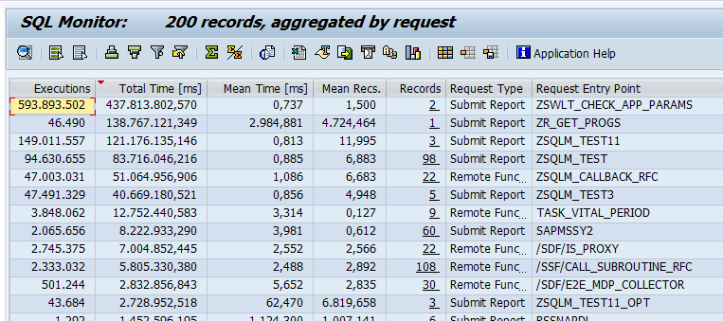
SQLM ( SQL Monitor )
This is a tool developed by SAP and available since NW 7.4 in all systems to monitor SQL statement performance in terms of DB Time, avg. time taken per request, DB Records, Iterations, over all consumption.
This is the recommended tool to be used in ABAP On HANA systems (production) w/o affecting performance.
Most expensive request entry point (Transaction, BG Job, Program, Report) In terms of DB Time
In these entry points itself, which SQL Query Dominates the SQL Profile
Most Expensive or Used Query in Whole System

Slide 6
SQL_M Architecture
When SQL Monitor is switched on
ABAP kernel logs information about DB accesses asynchronously via runtime monitor.
Monitoring data is moved periodically via a batch job to specific database tables.
SQL Monitor transaction reads data from these database tables.
Work Process
SQL Monitor Transaction
Runtime Monitor Data
Database Interface
Async.
Batch Job
SQLM Tables
Application Tables

Slide 7
SQL Performance Worklist Tuning
The SQL Performance Worklist Tuning (transaction SWLT) enables you to find ABAP SQL code that has potential for performance improvement. This tool combines information from static ABAP code scans that normally run in a test or quality system with runtime data from the SQL Monitor that typically originates from the productive system. Based on data records collected by the SQL Monitor, the SQL Performance Tuning Worklist automatically creates a worklist and allows you to rank the findings according to specific performance issues and their business relevance.
Findings from
SCI/ATC
Which are all
violation of
guidelines
SQLM tool for most
used and domination
SQL statements
What need to be fix?
Performance_DB : is the Check Static Variant.
Priorities

Slide 8
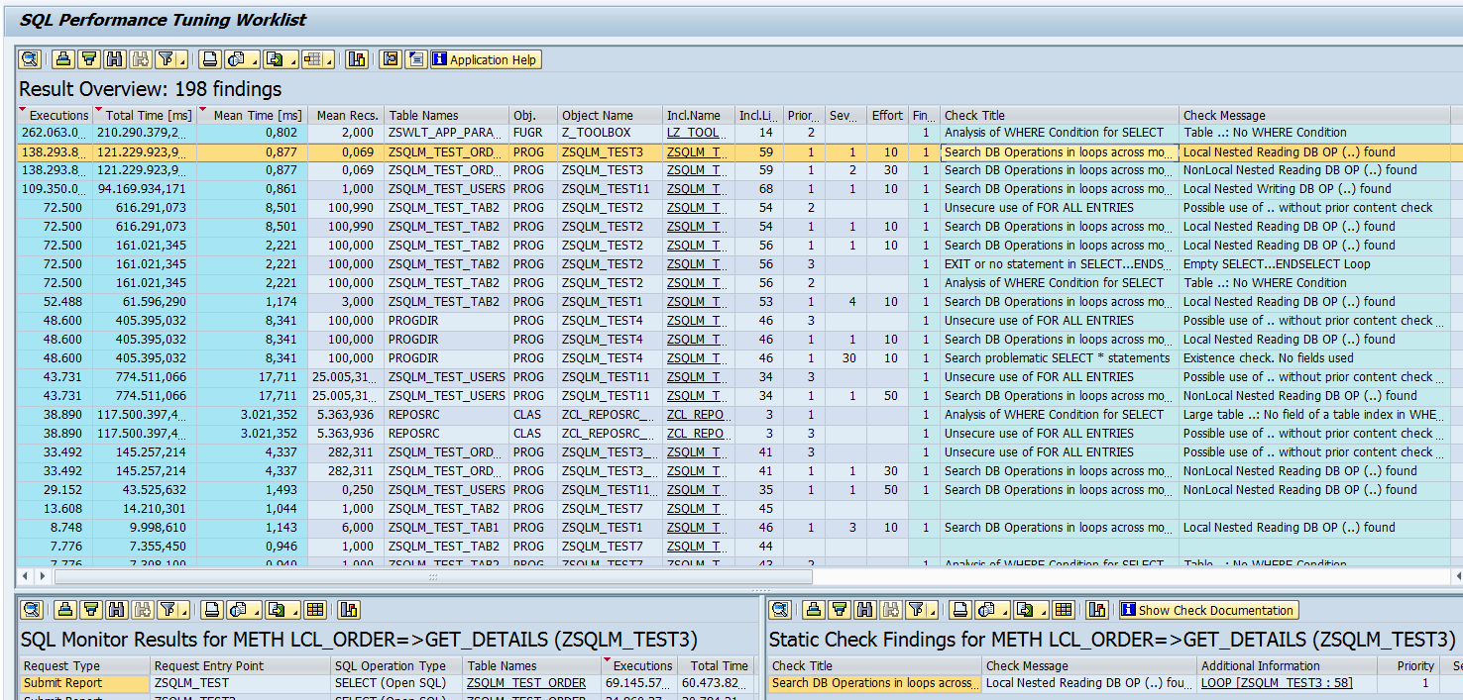
SQL Performance Tuning Worklist - Usage
Transaction SWLT provides a combined view with flexible navigation options
1
Ranked worklist
SQLM Data Different request entry points
ATC Results Detailed check results
2
3

Slide 9

Exercise 3
Performance DB Check

Slide 10

End of Day 5
Trainer: Anubhav Oberoy & Shubham Singh

Slide 11

Trainer: Anubhav Oberoy & Shubham Singh

Slide 12
THANK YOU
If you cannot do
great things, do small things in a great way.
Anubhav Oberoy & Shubham Singh
https://www.anubhavtrainings.com

Slide 13


We’re committed to empower you to be
Most Desirable Resource
through powerful training solutions.
We build the workforce of the future.
250+
Corporate Clients
30,000+
Learners Trained
25000+
Learners Placed
FREE WEBINARS
Sign up for free webinars with industry experts every fortnight!
Enroll Now!
Contact us today!
https://anubhavtrainings.com/

Slide 14




More from AnubhavTrainings.com

